Slide 1
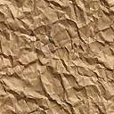
Traditional Cabled Geophone Data Acquisition System
Source (Vibrating truck with motor and piston)
Geophones(Sensor)
Vibrating Plate
Battery
1.
2.
3.
23.
24.
StrataVisor
Vibrational
Waves

